Slide 1
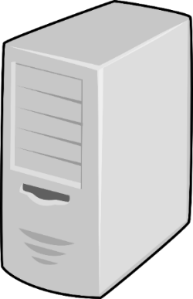
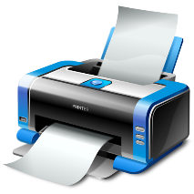
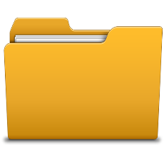

Windows System Administration
Telerik Software Academy
academy.telerik.com
File and Print Services
Borislav Varadinov
System Administrator
bobi@itp.bg

Slide 2

Table of Contents
Install File and Print Services
Managing File and Print Services
NTFS Permissions
Share Permissions
Distributed File System
File Server Resource Manager
Printing

Slide 3
Install File and Print Services
File Services provides technologies that help to:
Manage storage
Manage shared folders
Organize logical shared structure
Enable file replication
Print Services provides technologies that help to:
Share printers on a network
Share printers in Active Directory
Centralize print management tasks

Slide 4
Managing File and Print Services
File and Print Services are often deployed on the same machine
Both perform short transactions
Both work well together

Slide 5
File Services

Slide 6
File Sharing
Install File Services role
Manage file share resources
Access Control
Distributed File System Namespace (DFS-N)
Distributed File System Replication (DFS-R)

Slide 7
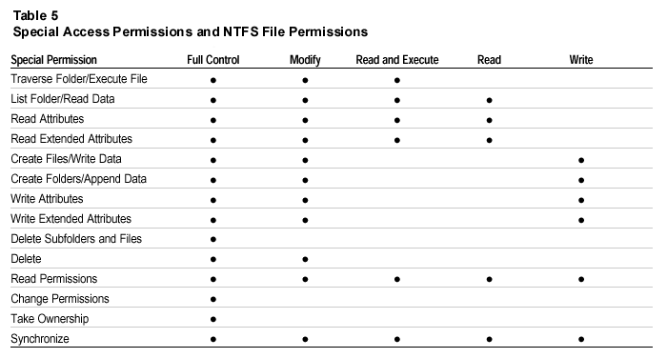
NTFS Permissions

Slide 8
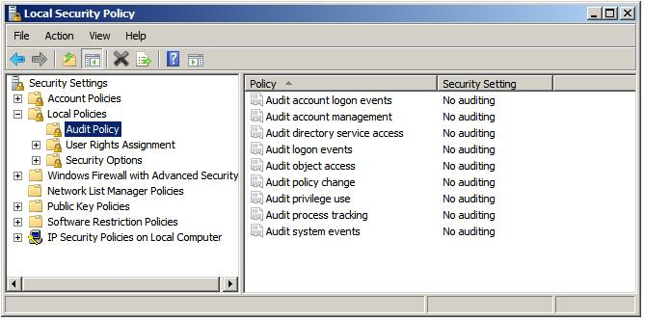
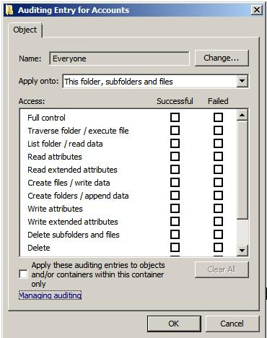
File System Auditing

Slide 9




Share Permissions
D:\Data
D:\Public
D:\IT
D:\IT\Dev
Share Permissions
NTFS Permissions

Slide 10
Access Control Good Practices
Role Based Access Control
Rule - Domain Local Group
Finance-Reporting-R
Finance-Reporting-W
Role - Global Groups
All-Finance-Users
All-Company-Users

Slide 11
File Server Resource Manager (FSRM)
Folder Quota
Storage Reports
File screening rules
Notes:
File screening rules that block files from a volume or a folder tree

Slide 12
DFS
DFS Namespace
Domain Based
Stand Alone
DFS Replication
Efficient, scalable and reliable Multi Master file replication
Notes:
USN Jornal
RDC

Slide 13
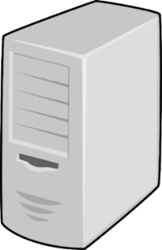

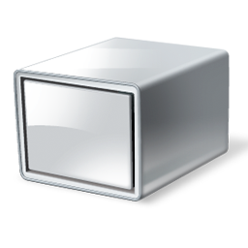

DFS Namespace
DFS Namespace (DFS-N)
DFS Folder Targets
Namespace Server
\\BGSFFS01\Software
Namespace Root
Software
\\LSS.Local\Public
Tools
\\BGSFFS02\Tools
Folder
Software
Tools
\\BGSFFS02\Documents
Tools
Folders with Targets
Tools
Docs
Tools
\\BGVRFS04\Training
Trainings
Trainings

Slide 14
DFS Replication
Efficient
Scalable
Reliable
Multi Master

Slide 15
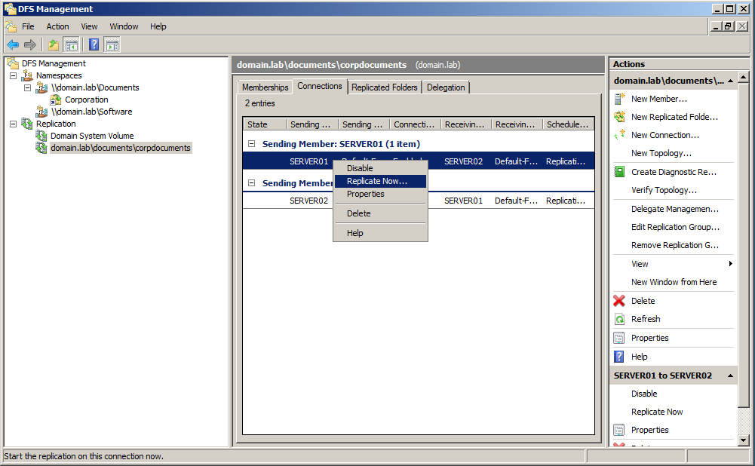
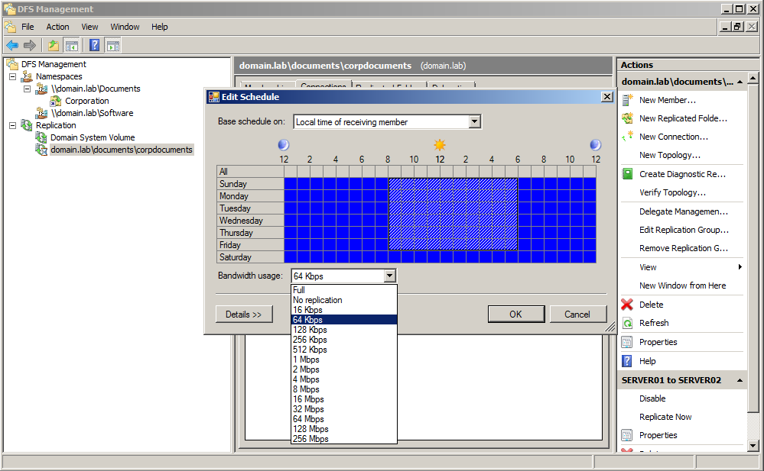
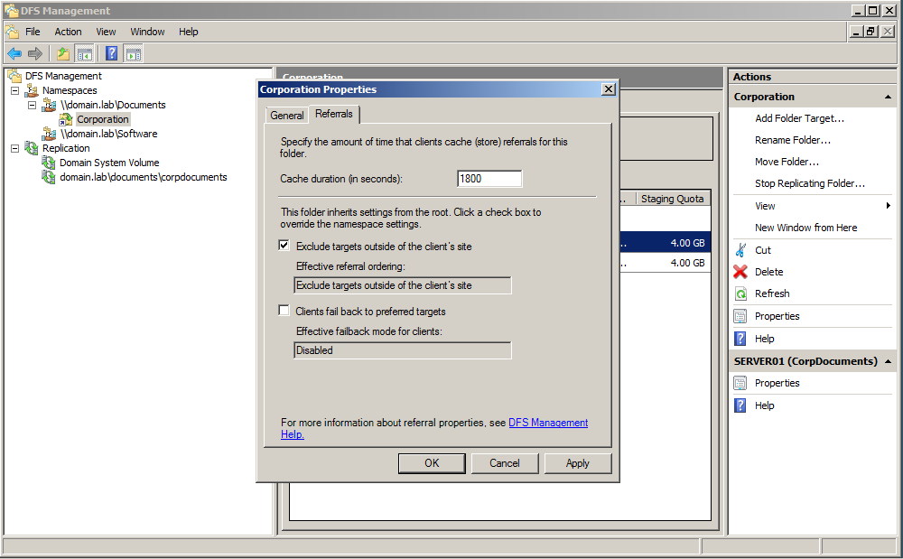
DFS Management Tools

Slide 16
DFS Management Tools
DFS Namespaces
Dfsutil.exe – manage DFSR roots, folders and targets
DfsDiag.exe – Diagnose configuration and integrity
DFS Replication
Dfsradmin.exe – Create/manage replication groups
Dfsrdiag.exe – Force/Stops replication, create reports

Slide 17
Printing

Slide 18
Printer Types
Locally attached printers (USB/Fireware)
Network attached printers (IP)
Windows Shared Printers (SMB/HTTP)

Slide 19
Print Components
Local printer device
Network printer device
Print client
Print server
Print queue
Printer driver
Print job
Print spooler

Slide 20

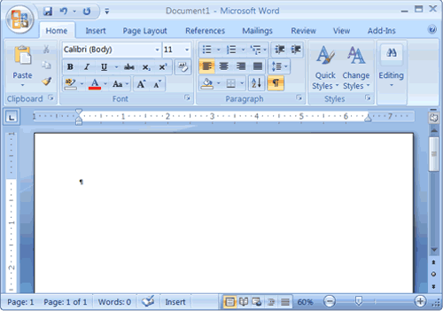


Print Process
Local Printer
Document
Print Server
Document

Slide 21
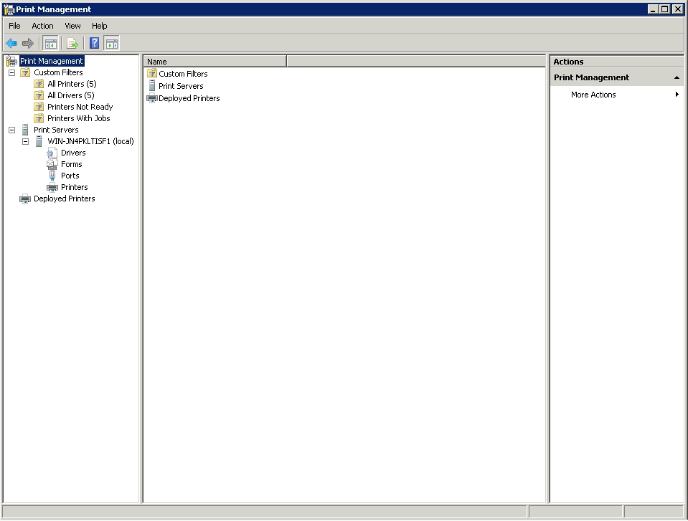
Print Management

Slide 22
Print Server
Print Queue
Active Directory
Description
Drivers
Share

Slide 23
Deploying Printers to Clients
Adding a local printer device
Adding a network printer device
Connecting to a network print queue using a UNC Path
Finding a network print queue using Active Directory
Adding printers using Group Policy

Slide 24
Changing Permissions on a Printer
Printers use permissions based on Access Control Lists to manage access and control usage
By using these permissions effectively
You can allow users to print to specific printers
You can allow certain users or groups to manage the print queues

Slide 25
Multiple Print Queues for a Single Printer
Manage permissions
Changing the Print Priority
Scheduling Printers

Slide 26
Creating a Printer Pool
Printer pool
Single print queue that sends jobs to multiple print devices
Requirements: you need to have two or more printers that can use the same printer driver

Slide 27
File and Print Services
http://academy.telerik.com

Slide 28




Free Trainings @ Telerik Academy
"Web Design with HTML 5, CSS 3 and JavaScript" course @ Telerik Academy
html5course.telerik.com
Telerik Software Academy
academy.telerik.com
Telerik Academy @ Facebook
facebook.com/TelerikAcademy
Telerik Software Academy Forums
forums.academy.telerik.com

